Slide 1
Asynchronous Order
Electrolux B2B

Slide 2
New order placement experience
Dear customer, we have done a change in our order placement process to give you an improved experience.
Currently
You are waiting for an order confirmation online from our system.
Now
You can just proceed after hitting ‘place order’ button, a notification on the screen will inform you about the status of the last order. Optionally you will receive an email confirmation about your order if you selected the option.

Slide 3
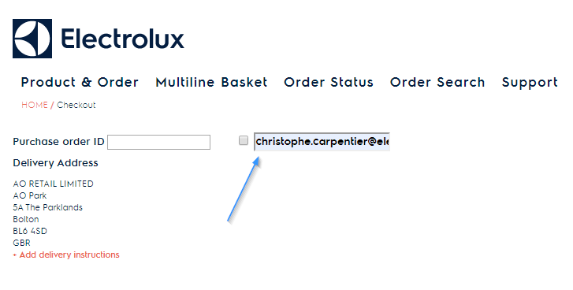
Order placement change
What’s new ?
You can tick the checkbox next to your purchase order ID to request confirm order email.* *option can be closed in your country
Default email is used from user preference

Slide 4
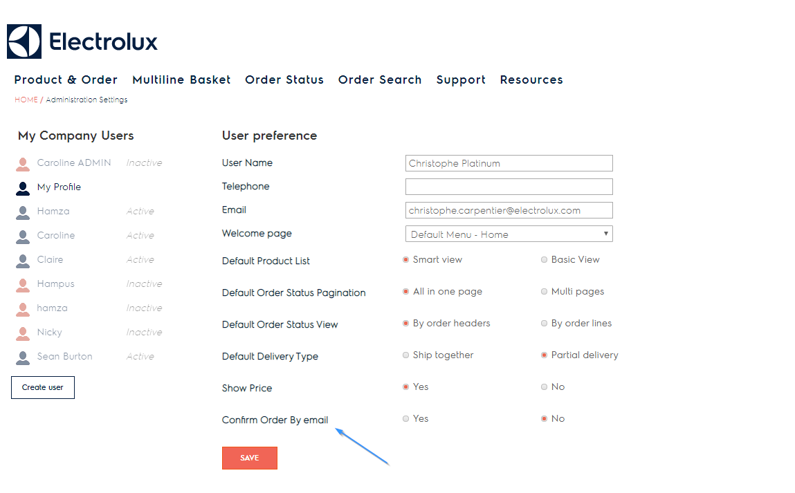
Order placement change
In User preference, you can set default to Yes or No for Confirm order by email.* *option can be closed in your country
If ‘Yes’ the checkbox in previous screen will be ticked by default
If ‘No’ you can tick the checkbox but it won’t be done by default

Slide 5
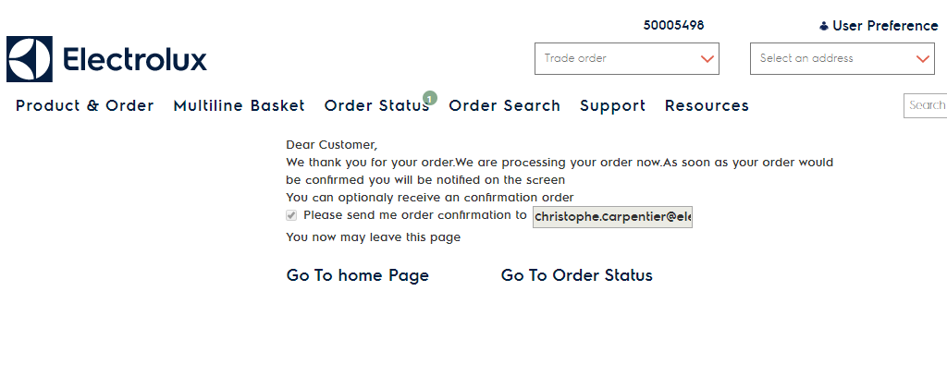
Order placement change
Your order is sent to our system. The thank you page will provide text about the order and If you entered an email for order confirmation, it will be reminded here.

Slide 6
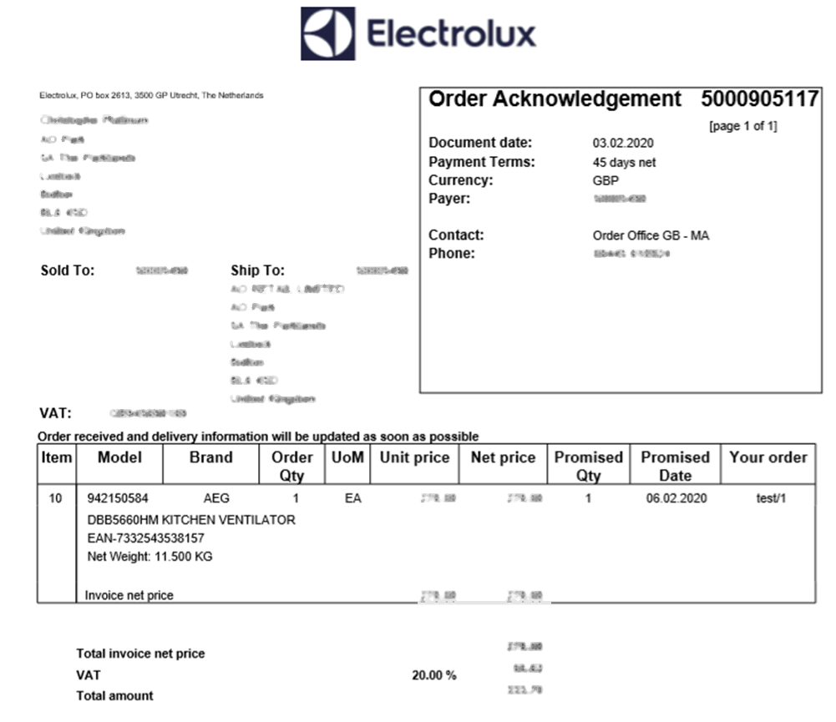
Order placement change
After your order has gone through and you requested the order confirmation to be sent to your email address. You will receive a document similar to the one shown on the right.

Slide 7
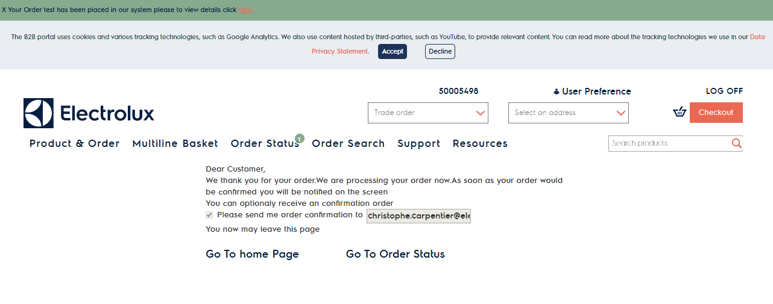
Notification
When the order is confirmed by our backend, you will see a green banner and a green counter on order status menu.

Slide 8
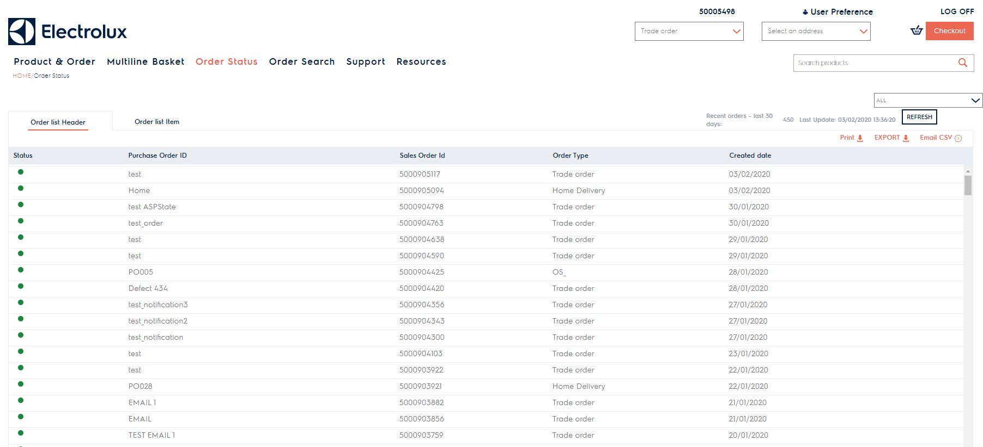
Order Status
By clicking on order status menu, the notification counter will be removed. In that section, we have no more pending tab but a new column status in both view (header, items) Pending is Amber, Confirmed is Green

Slide 9
New order placement experience
If you place one or several order(s) and you disconnect from the portal, notifications will remain when you reconnect until you access order status page (last order will be shown in notification banner) and count of order will be shown on order status menu.
See you soon on our B2B portal

