Slide 1
Focus Range and Favourites
Electrolux eBusiness

Slide 2
Focus Range and Favourites
We’ve added 2 new features to the Electrolux Tradeplace portal which are Focus Range and Favourites
Both features were develop to create a better experience for our customers making navigating through the portal and finding the models you want simpler.
Focus Range
It’s a menu item where you can find when hovering over products. On this page customers can manage the models on their focus range by adding models individually or uploading an excel file. The models will be visible on the focus range page with the same information you can find when searching like price and availability plus more. The focus range can be updated whenever required meaning you can add and remove models when required.
Favourites
Favourites will allow customers to select models to be inputted into their favourite’s range/page. All customers will need to do is to search for the models they want to favourite and click the ‘add to favourites’ hyperlink. Once clicked customers can click on ‘favourites’ page which is situated next to the user preference on the blue banner up top to find all their favourited items. On this page customers can find pricing and stock information with the ability to add some or all items into the basket. Additionally, customers can update the page by adding models manually using the add function of if they would like to remove, they can click ‘remove from favourites.

Slide 3
Focus Range
Focus range can be found by hovering over the menu item ‘Products’ and it will be the first option called ‘Focus Range’

Slide 4
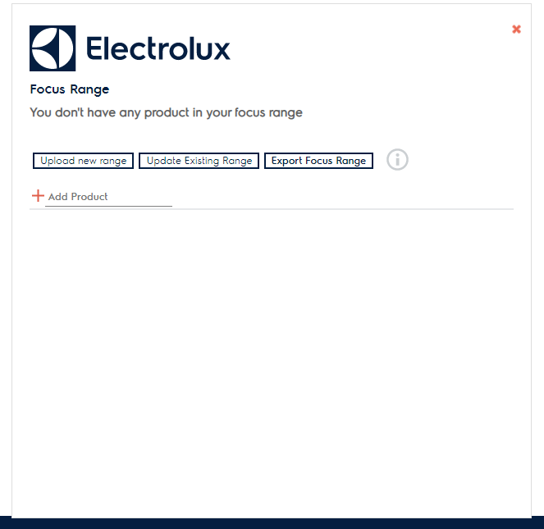
Focus Range
On the page you can add models to your focus range by clicking manage focus range
A window will appear with the following options
Upload new range – You can upload a list of models onto your focus range by uploading an excel file (see format next page)
Update existing range – you can add further models onto the range by uploading an excel file (see format next page)
Export focus range – you can export the models on your focus range to an Excel file.
Add Product – You can also manually add models to the focus range by adding the model code or PNC

Slide 5
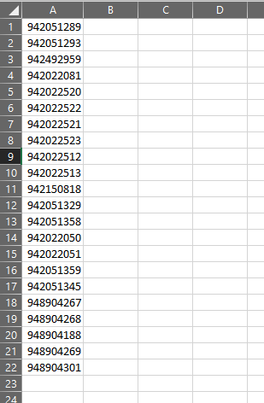
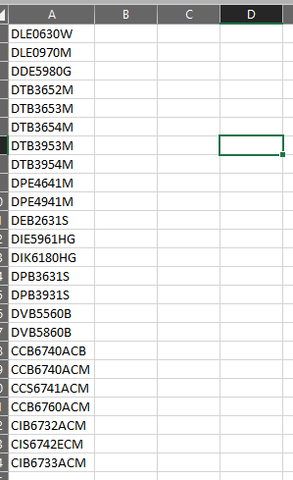
Excel file format for Focus Range
The excel file to upload or update focus range only needs to consist of the PNC or model code on column A.
Save as type – Excel workbook
Once created you can upload onto focus range

Slide 6
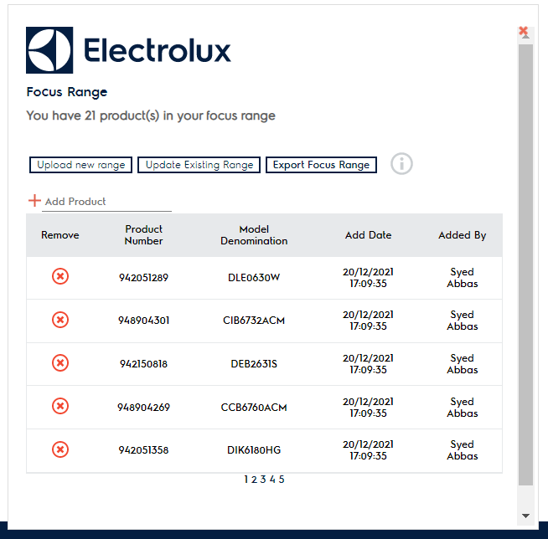
Focus Range
Once uploaded or added the models to the focus range the models will appear in the window with details when added and by whom.
When you have added all the models, click the red x on the top right corner of the window and then you will need to refresh the page. You can either press F5 or refresh your browser window.
X to close the window

Slide 7
Focus Range
Once refreshed the focus range will now showcase all the models selected. The page is similar to when looking at categories where you can find information on stock, pricing and other functionality like comparing models.

Slide 8
Focus Range – Things to Note
To remove a model on focus range you will need to go to ‘manage focus range’ and then click on the circled X to remove the model
You can export your focus range into an Excel file clicking ‘Export Focus Range’. It will supply the same details as you will see on the window
Do not upload a new range if you are looking to update the focus range. If you upload a new focus range, the previous focus range will disappear. To update click ‘update focus range’ if you want to update by file or add models manually.

Slide 9
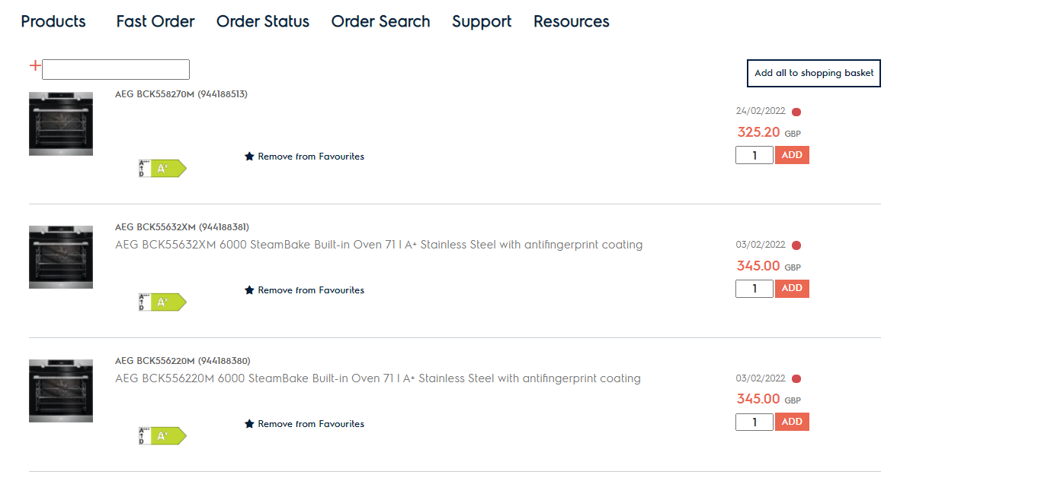
Favourites
You will find the favourites page on the blue banner at the top of your page next to ‘user preference’.
To favourite a model, find or search for the model and there should be an option ‘add to favourites’ with a star. Once you click it, the star should be highlighted to confirm the model is mark as a favourite.
Go to the favourites page and the models you favourited should now appear there. On this page you have the ability to add all models on the page to the shopping basket. Additionally, you can find information on availability and pricing.
You can manually add models to this page if you have the PNC/model code. You can also remove favourited items on the ‘Favourites’ page or through the portal wherever you see ‘remove from favourites’

