Slide 1
Electrolux Tradeplace/B2B New Product UI

Slide 2
New Product User Interface (UI)
We are pleased to announce that we have updated our product user interface on the Electrolux Tradeplace/B2B portal to provide a modern feel and to make finding and manoeuvring around the different categories easier.
We have also added a few requested features that will help with navigating content and gathering documentation.
The presentation showcases the new UI and features with descriptions about each one and how you will be able to make use. There are GIFs on page 8 and 9 that should start automatically but may need to be clicked on to start.
Update will be applied to UK and IE portals on the 14th of October 2021 for usage on the 15th of October 2021.

Slide 3
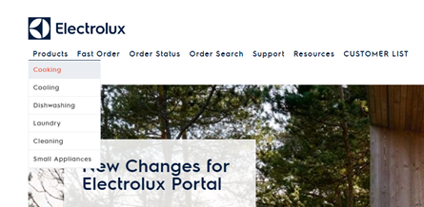
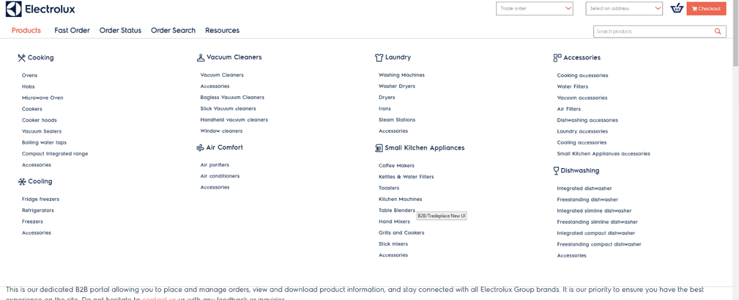
Products Dropdown Menu
Above is the current view of the Products dropdown. It only showcases the main categories
Above is the new products dropdown. We have expanded the dropdown which now includes the sub categories of the main categories allowing you to go directly to them.

Slide 4
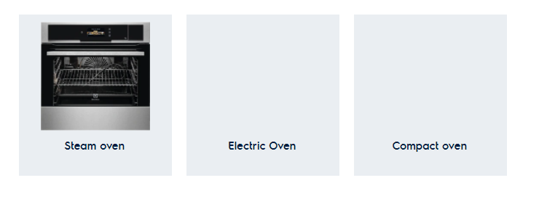
Categories and Sub Categories view
Categories and sub categories have a new feel. We have compacted them together for easier viewing. You can click through to get to the desired products. Sub categories are shown and if a sub categories have further sub categories they will also be displayed similarly.

Slide 5
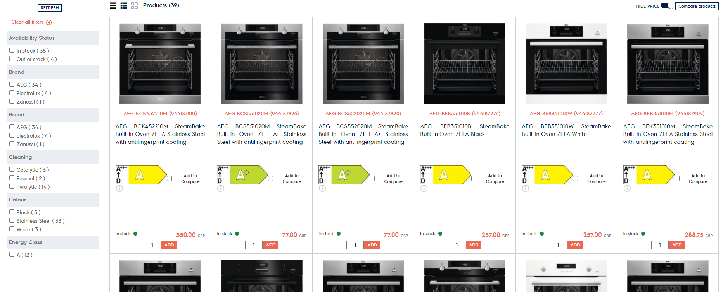
New Display View – Cards
We have build a new display called cards display. As you can see from above image the models are now compacted in blocks. Same information can be found and it provides a cleaner visualisation of models with less wasted space. You will still be able to use the simple and smart view if that is your preferred choice. Filter options are still on the left hand side.

Slide 6
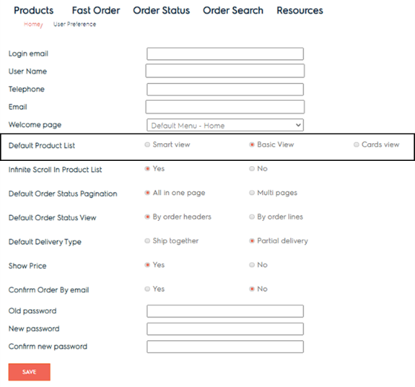
New Display View – Cards – How to activate
You can default any display view by going to user preference and selecting the view that you want defaulted and then hit save. Showcased on the right.
You can also change the view when on product list page by clicking on display card view with the symbol and that will change the display view. See below

Slide 7
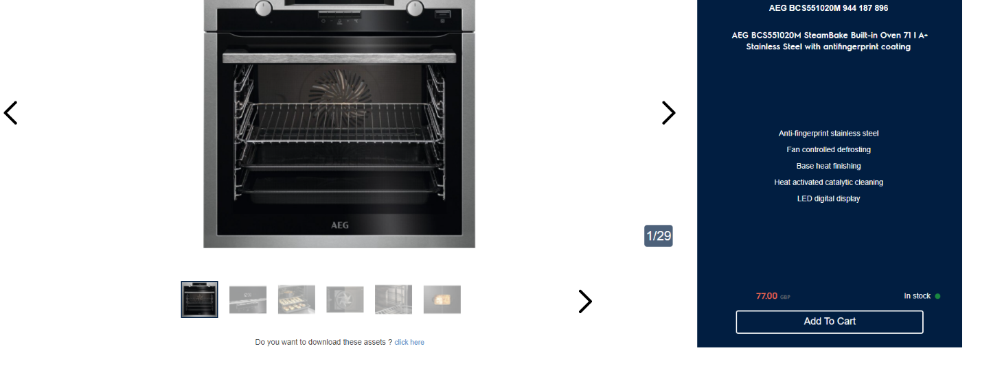
Revamped Product Detail Page
We have revamped our product detail page to give it a modern feel. We have changed the layout and added an all new scrolling functionality. Additionally, we are happy to introduce an image carousel to view the different images and content on a model. You will still be able to find product information and download documentation with the revamped page

Slide 8
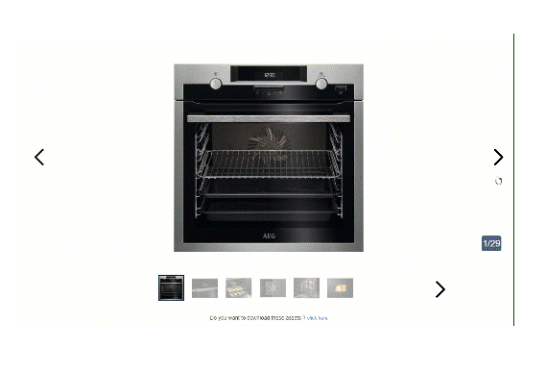
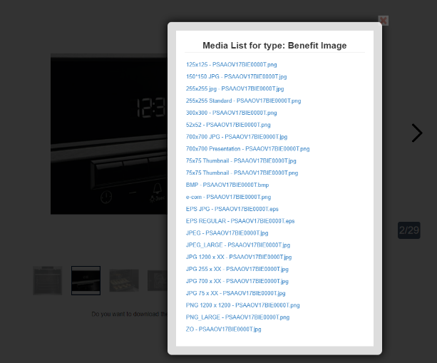
Product Detail Page – Image Carousel
You now have the ability to scroll through the media content of the model on the product detail page (GIF on the left). If you click on an image it will bring up media list type (Image on the right) where you can select the format and quality of the image to be used elsewhere.
If you want to see and download all available assets you can click ‘click here’ and it will open up a new page with all content.

Slide 9
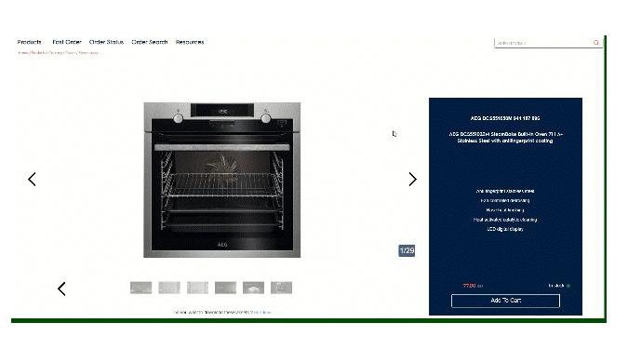
Product Detail Page – Scrolling Through
Scrolling through the product detail page you can see that the layout and display has changed but you still have access to all information and document of the model. If you want to go directly to an area you can use the flying menu at the top to take you directly there.

Slide 10
Thank you & Feedback
Thank you for going through the presentation. We hope the new changes and added functionalities are useful to you while using the Electrolux Tradeplace/B2B portal.
If you would like to provide feedback for the new updates or have any questions please get in touch. You can email the ESP inbox
Email - esp@electrolux.co.uk
Thank you
Electrolux eBusiness Team

